Slide 1
Billy - Buddy against Cyber Bullying
PIP2001 Capstone Project
FINAL REVIEW
Batch Number: ISE-01
Roll number | Student Name
20211ISE0005 | Sahana S Tadkal
20211ISE0009 | Ayush Aryan
20211ISE0031 | Yashawanth V B
20211ISE0053 | Bushra Begum
Under the Supervision of,
Mrs. Monisha Gupta
Professor
School of Computer Science and Engineering
Presidency University
Name of the Program: Information Science and Engineering
Name of the HoD: Dr. Pallavi R
Name of the Program Project Coordinator: Prof. Srinivas Mishra
Name of the School Project Coordinators: Dr. Sampath A K / Dr. Abdul Khadar A / Mr. Md Ziaur Rahman

Slide 2
Introduction
Cyberbullying is a growing issue, especially for teenagers, involving harmful behavior like spreading rumors, inappropriate remarks, and sharing personal info without consent.
Continuous harassment leads to anxiety, depression, and low self-esteem, with the potential for severe consequences.
Billybot Provides immediate support, anonymously collecting evidence, and reporting offenders to authorities.
Monitors cyberbullying trends and high-risk areas to inform victims and authorities.
Community Support fosters a safe space for victims to share experiences and receive peer support anonymously.
The goal is to Empower victims while protecting their privacy and security.

Slide 3
Literature Review
Sl.no | Title of the Paper | Authors | Technology/Concept Used | Results/Findings | Limitations/ Challenges
1 | Cyberbullying Among Adolescents: Impacts on Mental Health | Kowalski et al. (2014) | General analysis of psychological effects of cyberbullying | Victims of cyberbullying suffer from anxiety, depression, and suicidal thoughts. Real-time interventions needed. | Traditional interventions are insufficient, lacking real-time support.
2 | Causes and Consequences of Cyberbullying | Smith et al. (2019) | Anonymity in cyberbullying reporting | Anonymity encourages more victims to report incidents; fear of retaliation is a major barrier to reporting. | Fear of retaliation remains a strong deterrent to seeking help without anonymity.
3 | NLP and Conversational Agents in Cyberbullying Prevention | Dehghani et al. (2018) | Natural Language Processing (NLP) for creating empathetic chatbots | NLP-based chatbots provide a non-judgmental space for victims to express their emotions and seek help. | Reluctance to speak to human operators persists, chatbots must handle complex emotions.
4 | Encouraging Victims to Report Cyberbullying | Barlett et al. (2016) | Anonymous reporting systems | Anonymous reporting significantly increases the likelihood of victims coming forward. | Fear of social consequences is a persistent issue, even with anonymity.

Slide 4
Literature Review
Sl.no | Title of the Paper | Authors | Technology/Concept Used | Results/Findings | Limitations/ Challenges
5 | The Importance of Digital Evidence in Cyberbullying Cases | Hinduja and Patchin (2015) | Digital evidence collection for cyberbullying reporting | Victims must be educated on how to preserve digital evidence for reporting cyber-crime cases effectively. | Lack of knowledge among victims regarding how to gather and submit relevant evidence.
6 | Crime Data Visualization and Real-Time Cyberbullying Statistics | Brewer and Kerslake (2015) | Data visualization for tracking crime trends | Real-time data visualization helps law enforcement and policymakers address cyberbullying more effectively. | Visualization of real-time data may lack accuracy if not updated frequently.
7 | Emotional Impacts of Cyberbullying and Social Withdrawal | Tokunaga (2010) | Psychological analysis of cyberbullying victims | Victims often experience isolation, anger, and frustration, which exacerbates the emotional toll of cyberbullying. | Emotional recovery remains slow without peer support and community-building efforts.
8 | Peer Support as a Coping Strategy for Cyberbullying Victims | Aljohani et al. (2019) | Real-time communication frameworks (Socket.IO) | Real-time feedback and support improve user engagement and provide immediate emotional assistance to victims. | Real-time systems require high availability and reliability to be effective in sensitive cases.

Slide 5
Literature Review
Sl.no | Title of the Paper | Authors | Technology/Concept Used | Results/Findings | Limitations/ Challenges
9 | Real-Time Communication in Cyberbullying Prevention Platforms | Aljohani et al. (2019) | Real-time communication frameworks (Socket.IO) | Real-time feedback and support improve user engagement and provide immediate emotional assistance to victims. | Real-time systems require high availability and reliability to be effective in sensitive cases.
10 | Secure Data Handling in Cyber-Crime Reporting Platforms | Kumar and Nanda (2018) | Data encryption and secure authentication for user data | Prioritizing encryption and secure authentication protect user data and encourages reporting of cyber-crime. | Maintaining high levels of security may impact system performance and ease of use.

Slide 6
Research Gaps Identified
Limited Real-Time Support
Minimal User Engagement
Limited Scalability
Insufficient Focus on Prevention

Slide 7
Proposed Method
Billybot is Built with a pre-trained GPT-3.5-Turbo model for empathetic responses.
Designed with a strong focus on privacy, allowing victims to report incidents without fear of exposure.
HTML5, CSS3, JavaScript, and React.js provide a simple, user-friendly interface for reporting.
MongoDB handles unstructured data, offering scalability and support for distributed data with sharding.
Express.js manages requests and API routing, connecting to MongoDB for secure data storage.

Slide 8
Objectives
To Provide Real-Time Emotional and Psychological Support to Cyberbullying Victims
To Create a Secure and Anonymous Reporting System for Cyberbullying Incidents
To Educate Victims on Gathering and Reporting Digital Evidence
To Leverage Real-Time Communication and Data Visualization for Cyberbullying Trends

Slide 9
System Design & Implementation
HTML5 and CSS3 are used for the home, login, and register pages, with JavaScript handling interactivity, form validation, and animations.
React.js is used to build the user interface for the chatbot and Q&A community, ensuring smooth and responsive interactions.
Tailwind CSS integrated with React.js for a visually appealing, responsive design.
Node.js and Express.js handle API calls, user authentication, and chat processing.
Uses pre-trained GPT-3.5-Turbo model to provide chatbot responses and assist with evidence collection and reporting.
JWT encryption secures user data during registration.
MongoDB stores user data, chat logs, community discussions, and crime statistics.

Slide 10
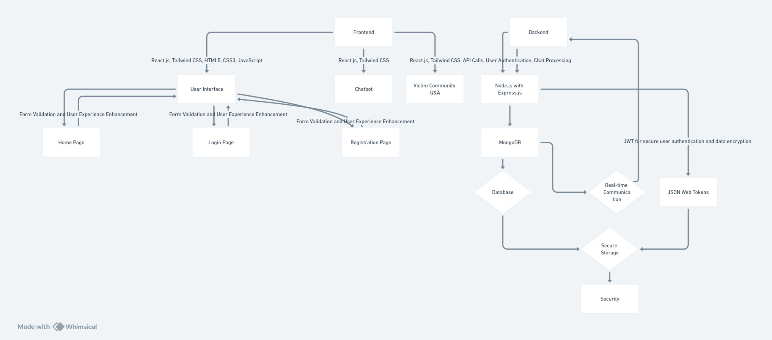
Architecture

Slide 11
Software components
Frontend: HTML5,CSS3, JavaScript, React.js, Tailwind CSS
Backend: Node.js and Express.js, Socket.IO
Pre-Trained Model Integration: GPT-3.5-Turbo
Database: MongoDB
Security: JWT

Slide 12
Timeline of Project

Slide 13
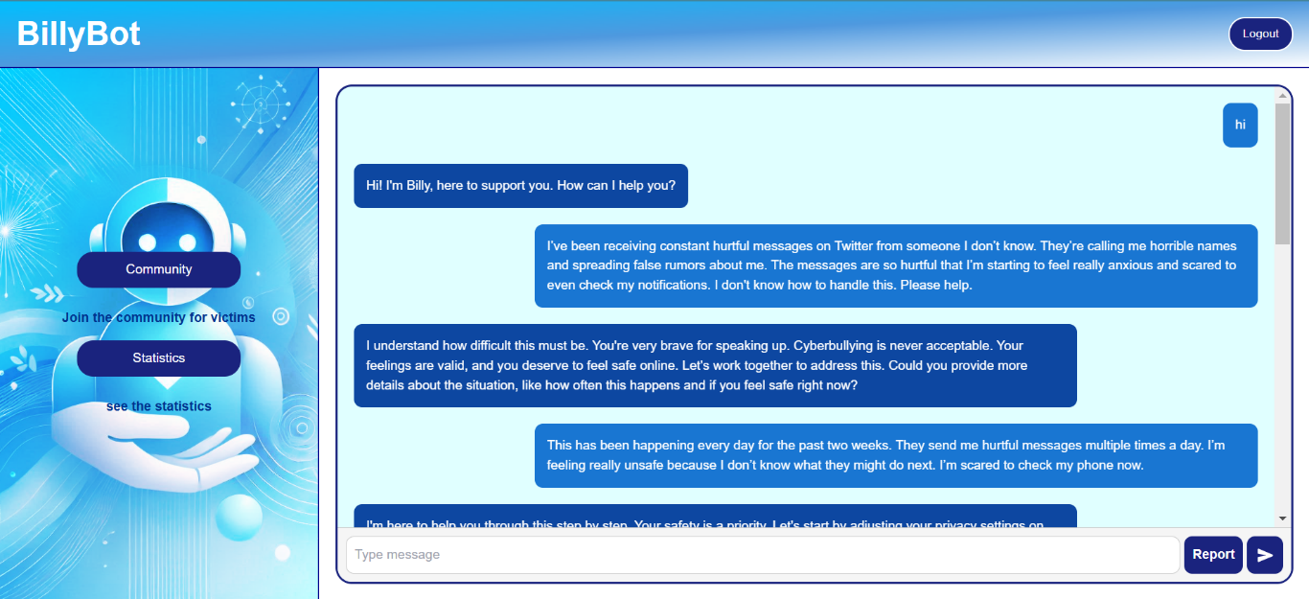
Project’s Results
Chatbot’s responses

Slide 14
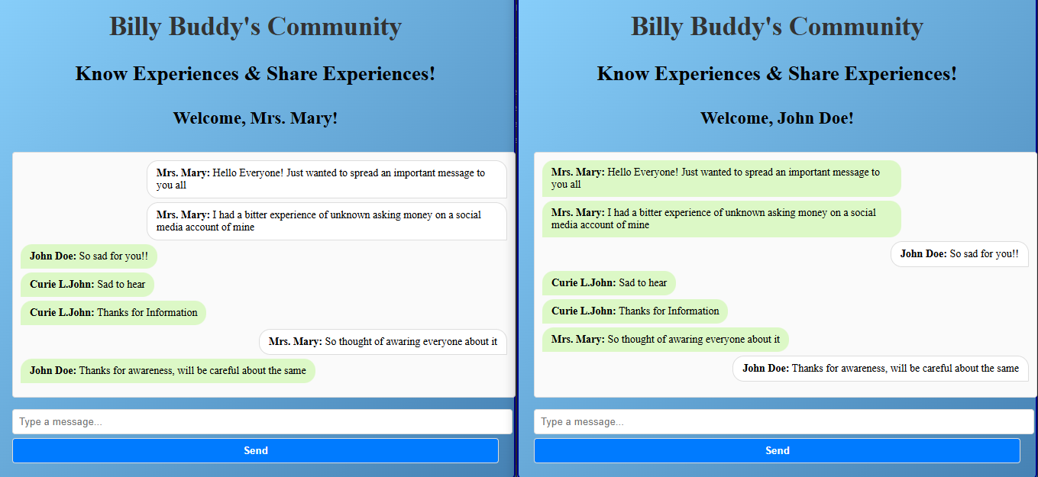
Victims’ Community

Slide 15
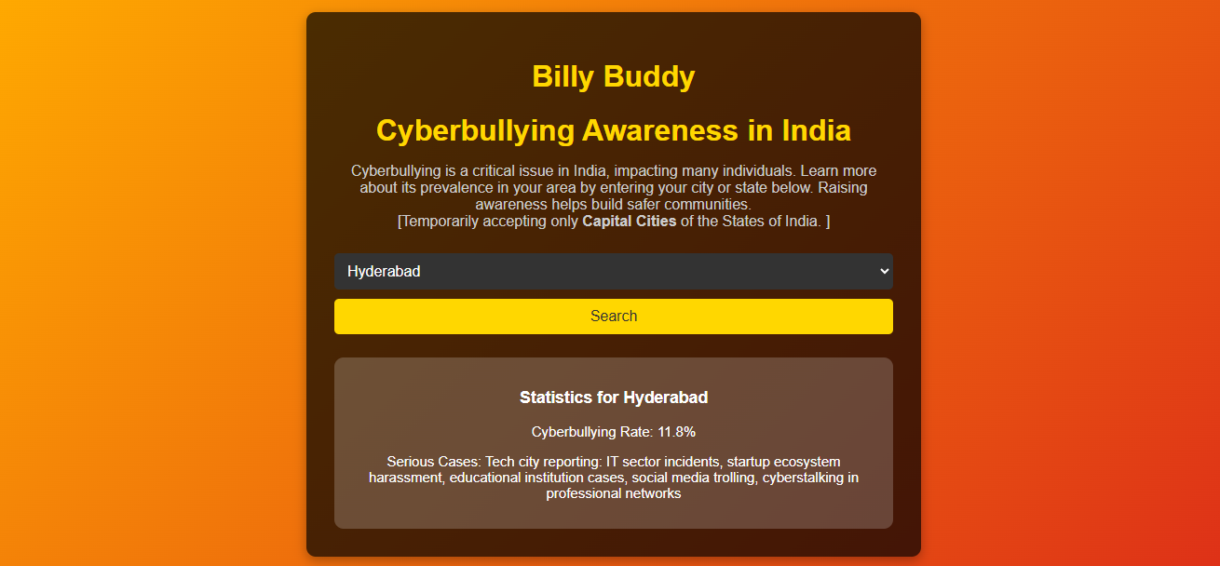
Statistics page

Slide 16
Outcomes
Emotional Support
Anonymous Reporting
Data Security
Cybercrime Statistics
Victim Community
Scalable Architecture
Victim Empowerment
Offender Deterrence

Slide 17
Conclusion
AI-powered platform to combat cyberbullying, integrating pre-trained OpenAI model for real-time emotional support.
Focuses on creating a secure, empathetic environment for victims, providing guidance without judgment.
Prioritizes data security through end-to-end encryption, ensuring confidentiality and encouraging victims to report incidents.
Real-time communication enabled via Socket.IO, offering instant responses and support.
Tracks and analyzes real-time cybercrime statistics, helping identify trends for law enforcement and policymakers.
Comprehensive tool addressing emotional, practical, and technical aspects of cyberbullying.

Slide 18
References
[1]. Kowalski, R. M., Giumetti, G. W., Schroeder, A. N., & Lattanner, M. R. (2014). Bullying in the digital age: a critical review and meta-analysis of cyberbullying research among youth. Psychological bulletin, 140(4), 1073.
[2]. Smith, P. K. (2019). Research on cyberbullying: Strengths and limitations. Narratives in research and interventions on cyberbullying among young people, 9-27.
[3]. Kiritchenko, S., Nejadgholi, I., & Fraser, K. C. (2021). Confronting abusive language online: A survey from the ethical and human rights perspective. Journal of Artificial Intelligence Research, 71, 431-478.
[4]. Barlett, C. P., DeWitt, C. C., Maronna, B., & Johnson, K. (2018). Social media use as a tool to facilitate or reduce cyberbullying perpetration: A review focusing on anonymous and non-anonymous social media platforms. Violence and gender, 5(3), 147-152.
[5]. Hinduja, S., & Patchin, J. W. (2021). Digital dating abuse among a national sample of US youth. Journal of interpersonal violence, 36(23-24), 11088-11108.
[6]. Antisdel, J. L. (2024). Data Mining Teen Narratives on Reddit: Revealing Insights in Cyber Victimization Experiences (Doctoral dissertation, Indiana University Indianapolis).

Slide 19
References
[7]. Tokunaga, R. S. (2010). Following you home from school: A critical review and synthesis of research on cyberbullying victimization. Computers in human behavior, 26(3), 277-287.
[8]. Morin, H. K., Bradshaw, C. P., & Kush, J. M. (2018). Adjustment outcomes of victims of cyberbullying: The role of personal and contextual factors. Journal of school psychology, 70, 74-88.
[9]. Upadhyay, U., Kumar, A., Sharma, G., Gupta, B. B., Alhalabi, W. A., Arya, V., & Chui, K. T. (2023). Cyberbullying in the metaverse: A prescriptive perception on global information systems for user protection. Journal of Global Information Management (JGIM), 31(1), 1-25.
[10]. MR, N. K., Vishwachetan, D., DM, M. A., Dayananda, K. J., Manasa, K. J., & Nanda, K. V. (2024, February). An Efficient Approach to Deal with Cyber Bullying using Machine Learning: A Systematic Review. In 2024 Second International Conference on Emerging Trends in Information Technology and Engineering (ICETITE) (pp. 1-8). IEEE.
[11]. Sanu, E., & Mummigatti, M. (2023, November). Design of Chatbot to Prevent Cyberbullying from Social Media. In 2023 International Conference on Sustainable Communication Networks and Application (ICSCNA) (pp. 1437-1441). IEEE.

Slide 20
References
[12]. Falade, P. V. (2024). Deciphering ChatGPT's Impact: Exploring Its Role in Cybercrime and Cybersecurity. Int. J. Sci. Res. in Computer Science and Engineering Vol, 12(2).
[13]. Faraz, A. (2022). Protectbot: A Chatbot to Protect Children on Gaming Platforms. Rochester Institute of Technology.

Slide 21

Project work mapping with SDG
SDG 3: Good Health and Well-being
SDG 16: Peace, Justice, and Strong Institutions
SDG 9: Industry, Innovation, and Infrastructure

Slide 22
Publication Details
Publication Name: International Journal of Innovative Research in
Technology (IJIRT) - an UGC approved journal
ISSN: 2349-6002
UGC Approved Journal No 47859
ESTD Year: 2014
Reseach Paper ID: 170976
Link: https://ijirt.org/Article?manuscript=170976

Slide 23
Thank You

